Slide 1
Florida Agriculture Financial Management Conference
Dr. Paul C. Genho
August 2015

Slide 2
Format of Presentation
Long-Term Projection for US Agriculture
Methodology for Risk-Return Analysis

Slide 3
Principle
Western Hemisphere, and US in particular is, and will be, the food Basket of the World

Slide 4
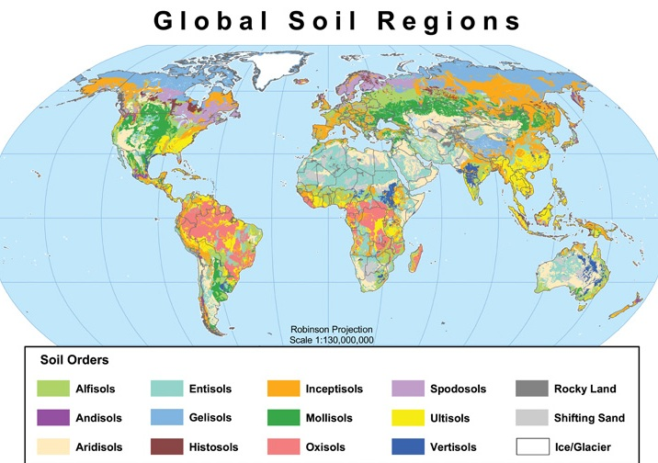

Slide 5
Impact of Soil Order on Yield
 | Mollisol | Alfisol | Ultisol | Oxisol
Corn Yield* | 175 | 150 | 141 | 130
Additional fertilizer costs** |  |  | +$20 | +$25

Slide 6
U.S. is a Blessed Land
6.7% of land area
4.2% of population
21% of Mollisols

Slide 7
Hunger is a Major Issue and going to get worse

Starvation is a reality for many

Slide 8
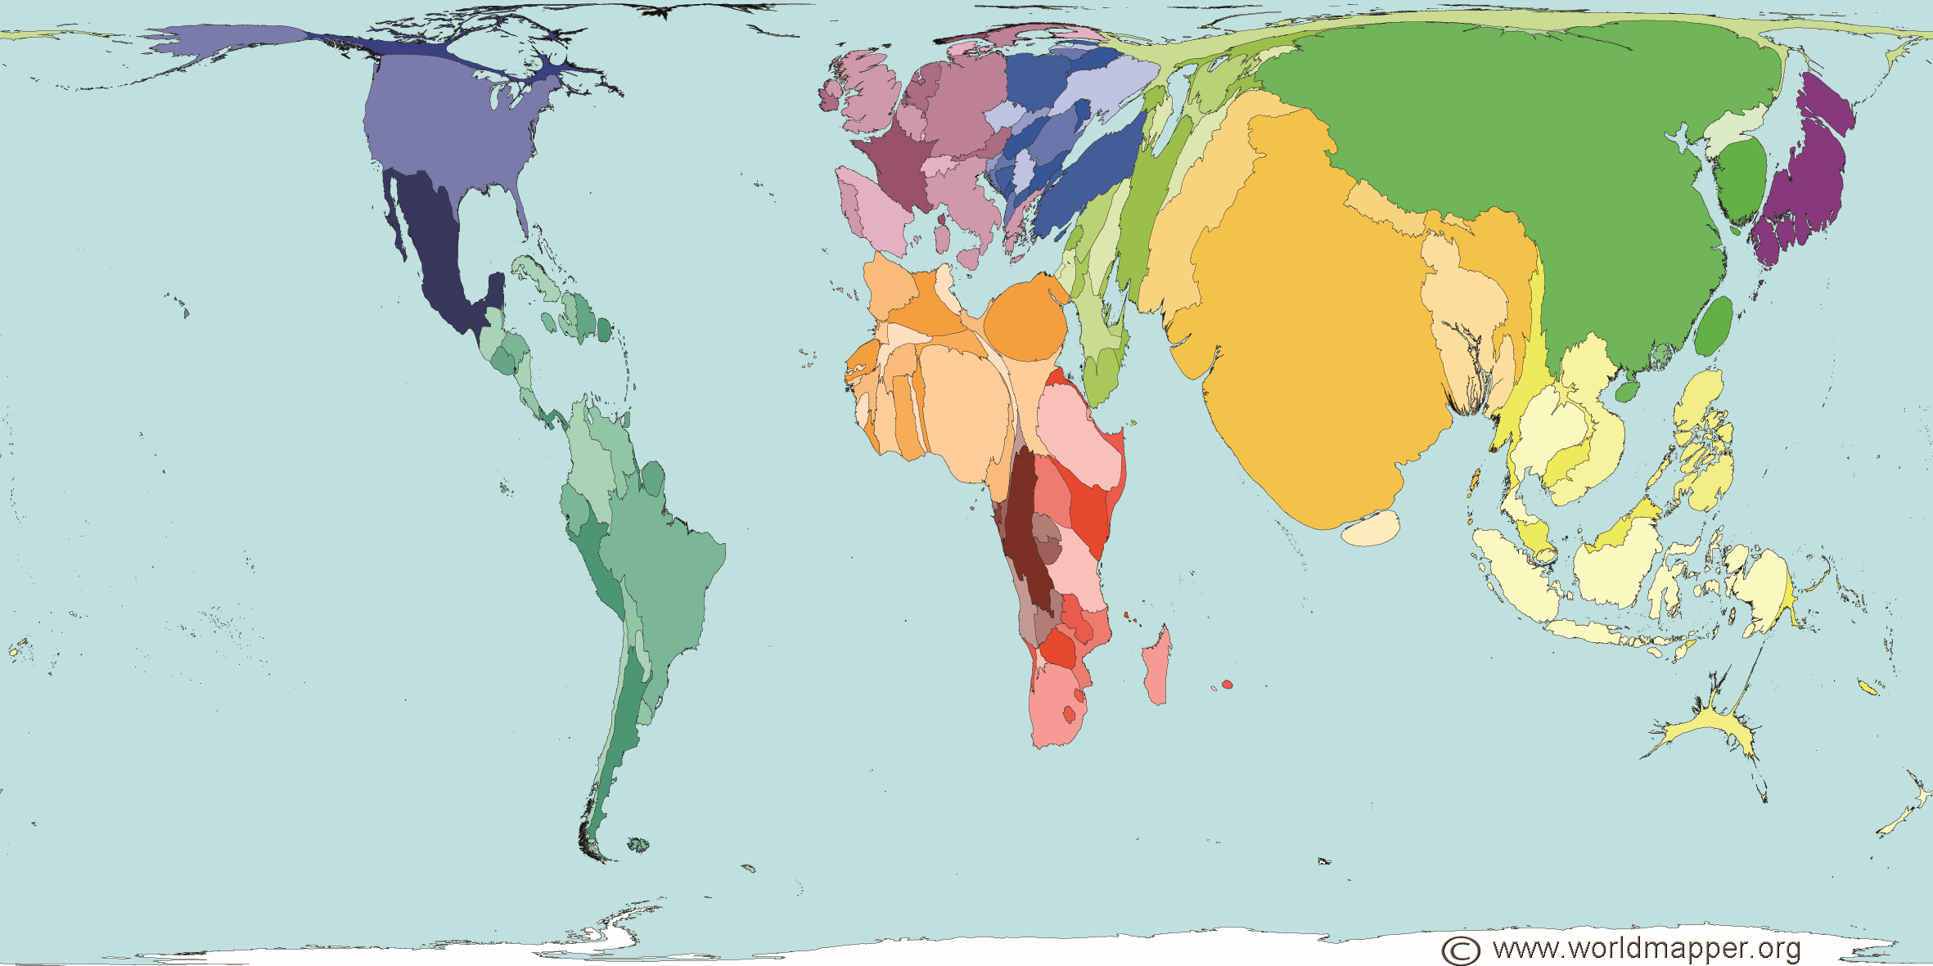
World Map in Proportion to Population
Notes:
China 1.4 Billion, India 1.3 billion, Africa 1.1 billion
60% of world population lives in Asia
15% in Africa
5% in North America
5% in South America

Slide 9
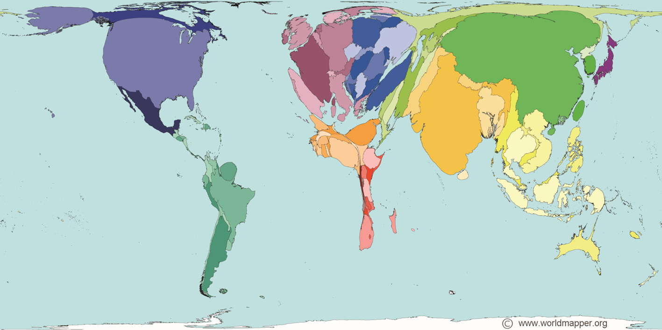
World Map in Proportion to Grain Production
Notes:
Corn Wheat Rice
US China, Brazil Ukraine India

Slide 10
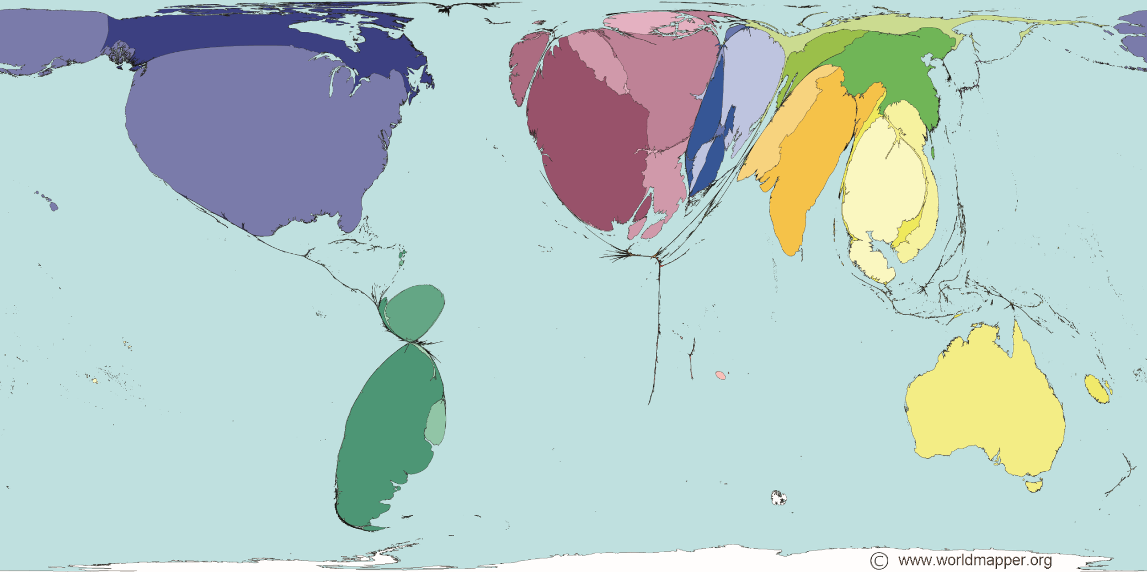
World Map in Proportion to Grain Exports

Slide 11
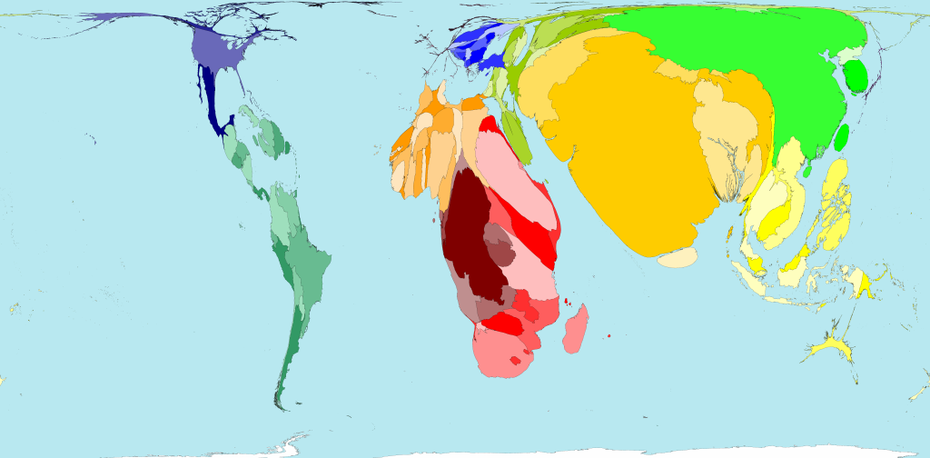
World Map in Proportion to Undernourishment

Slide 12
Hunger Around the World
1 billion people go to bed hungry every day
6 million children will die this year from malnutrition
1,000 children will die from malnutrition during this presentation

Slide 13
Population Growth

Slide 14
Population Growth
80 million people annual world population growth
Annual growth equivalent to population of Germany

Slide 15
Growing Demand
The UN-FAO estimates that the world will need 70% more food by 2050
It will be, to a great degree, supplied by the Western Hemisphere, in particular the U.S.
Notes:
1. UN FAO report

Slide 16
Geo-Political Influence of Food
“IT IS sadly appropriate that Mohamad Bouazizi, the Tunisian whose self-immolation triggered the first protest of the Arab spring, should have been a street vendor, selling food. From the start, food has played a bigger role in the upheavals than most people realize. Now, the Arab spring is making food problems worse.”
The Economist

Slide 17
Correlation of Commodity Prices
Oil is King
  Energy prices affect all commodities
Corn is Queen
  All food commodities follow corn
Gold is the Joker

Slide 18
Food/Oil Correlation
Oil is King
Notes:
Energy counts for about 30% of the cost of food.

Slide 19
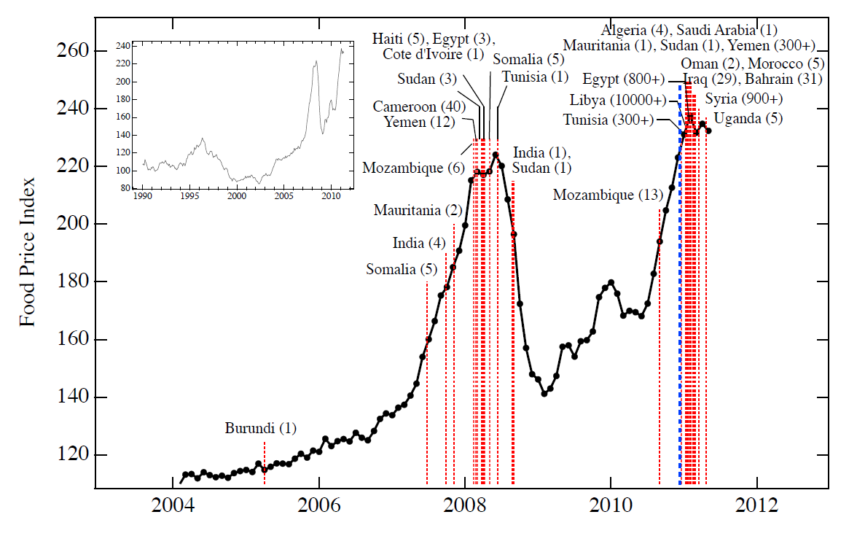
Food Prices and Instability

Slide 20
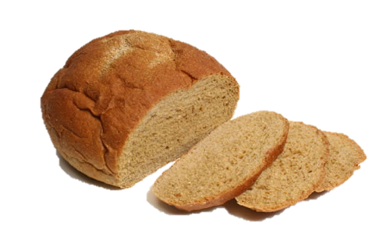
Factors that Aggravate the Issue
Higher Food Prices
Civil Unrest
Higher Oil Prices

Slide 21
Expenditure of Consumptive Income for Food
Country | Food, % of income | Food, cost per capita
United States | 6.4 | $2,087
Germany | 11.0 | $2,425
China | 22.3 | $338
Brazil | 24.8 | $1,641
India | 27.7 | $223
Russia | 29.0 | $1,561
Tunisia | 35.6 | $862
Egypt | 38.0 | $842
Morocco | 40.5 | $777
Jordan | 40.6 | $1,183
Ukraine | 41.7 | $770
Pakistan | 41.9 | $320
Algeria | 43.7 | $674
Azerbaijan | 45.3 | $1,028
Cameroon | 46.9 | $369
* Pink denotes significant civil unrest
USDA ERS 2010

Slide 22
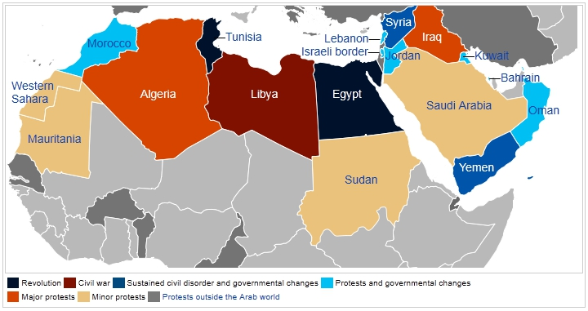
Food Prices and Instability
Arab Spring

Slide 23
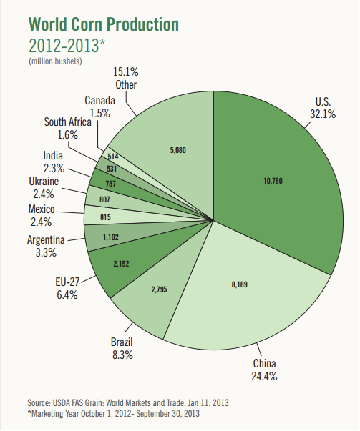
Corn Production by Country
Corn Yields
US 172 bu./ac. China 93 bu./ac.

Slide 24
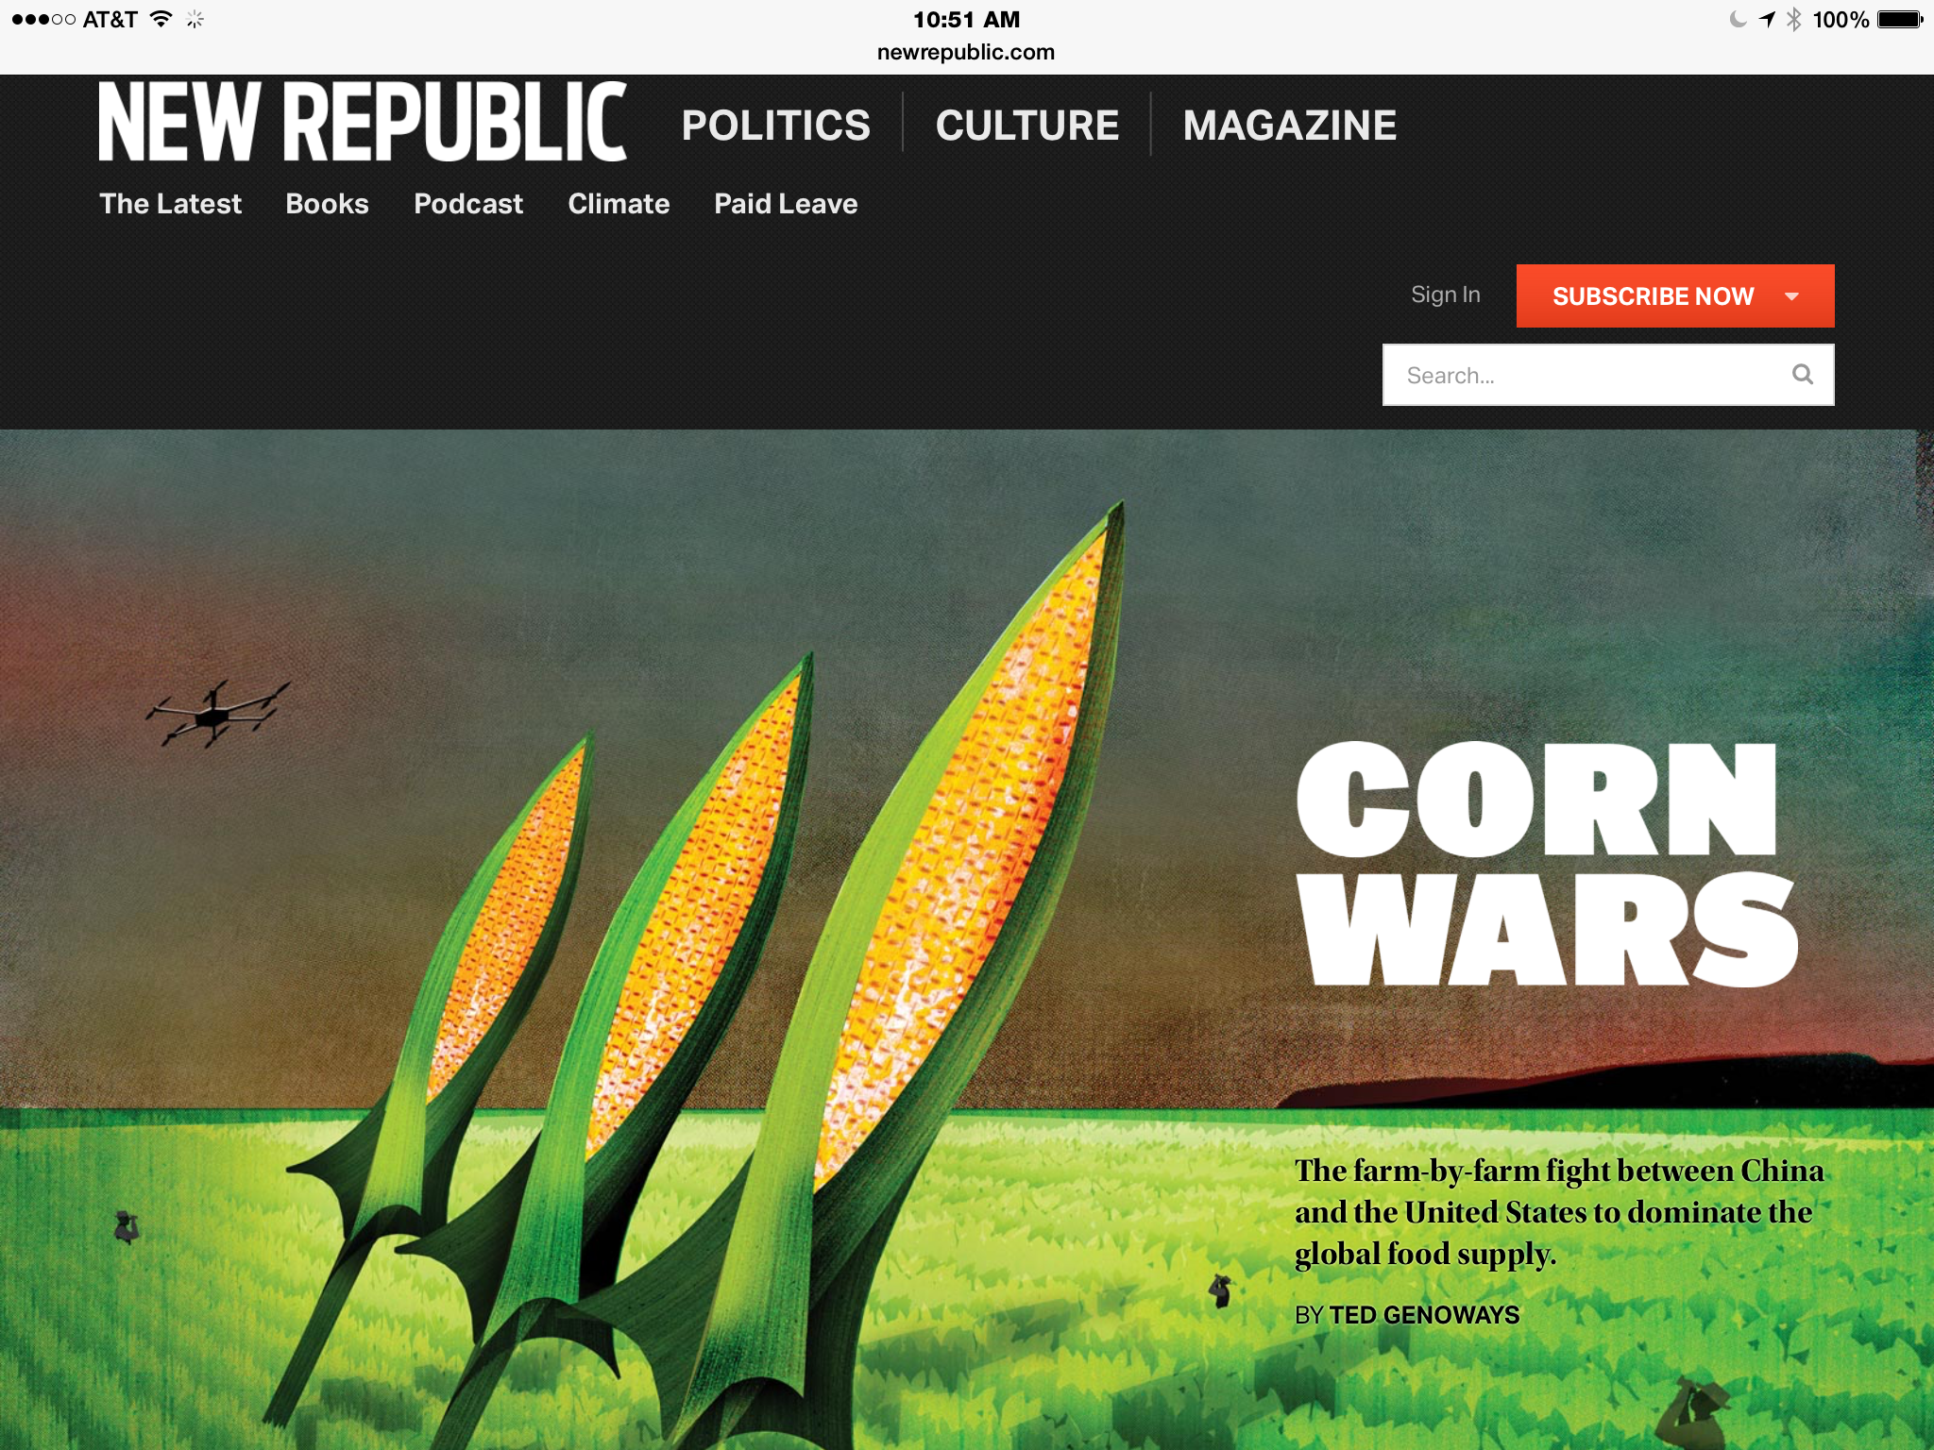

Slide 25
The Rising Middle Class
Size of the Middle Class, 2009-2030
(millions of people and global share)
Brookings Institution, 2011

Slide 26
What About Beef?
Growing middle class demands “better” diets
  China, India, Mexico, Brazil, etc.
  ⬆ Meats, Dairy, Nuts
Result: Greater demand and higher prices for commodities

Slide 27
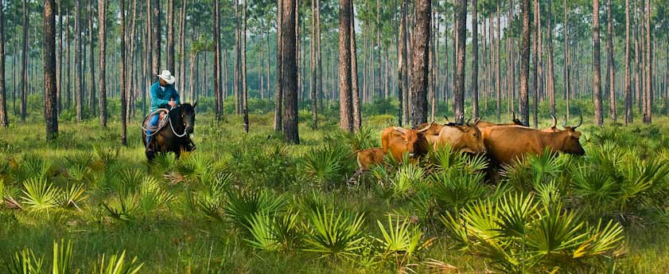
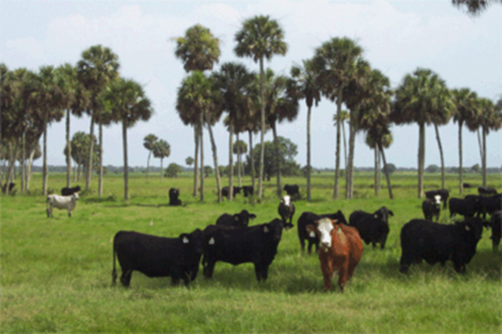
Investing in Agri Land

Slide 28
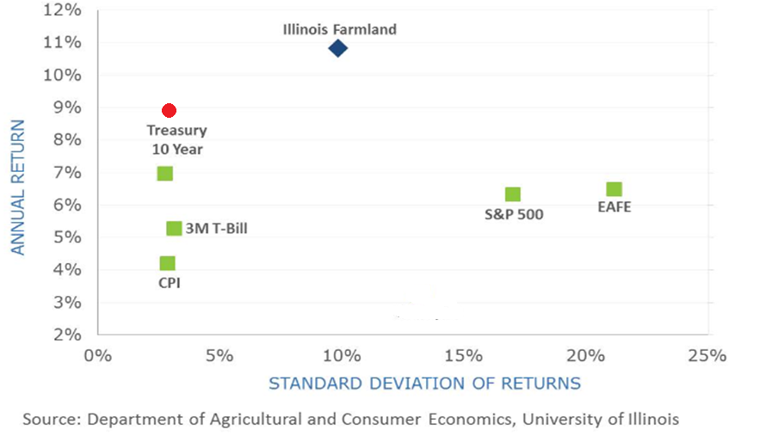
Return vs. Volatility
(1970 – 2012)

Slide 29
Hurdle Rate Model
Hurdle Rate = Risk Free Rate + Project Risk Premium
10-year Treasury Yield
(5%)
Weighted Land and Operational Risk as determined by variances

Slide 30
Glossary
Hurdle Rate = minimum ROI that a company expects to earn when investing
Risk Free Rate = Rate of return with zero risk. (10-year Treasury) Typically ~ 5%
Risk Premia = The rate of return above the risk-free rate (5%). For example: S&P typically returns 11% and risk-free rate is typically 5%. Then 11% - 5% = 6%
Sharpe Ratio = Methodology for analyzing risk-return ratio (0.4)

Slide 31
Principle
The total Risk/Return ratio of an agricultural operation depends upon proportions of the investment in land and operations

Slide 32
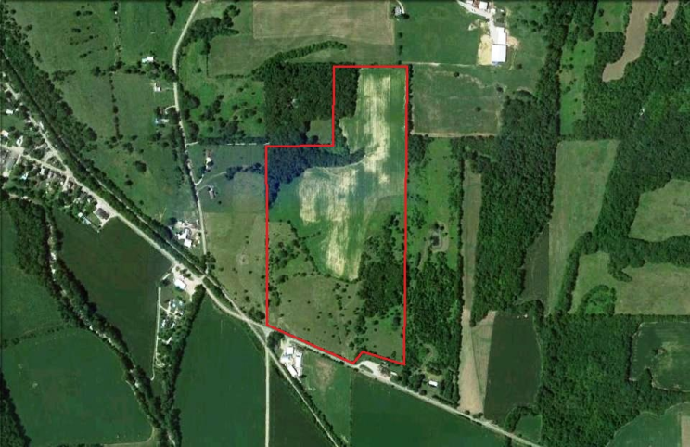
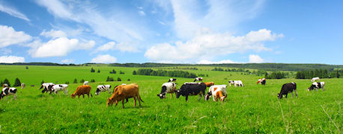
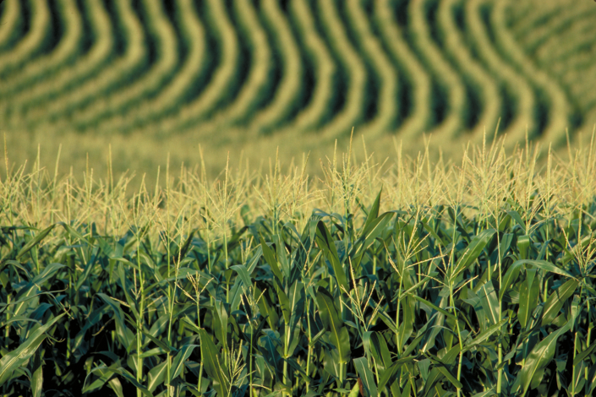
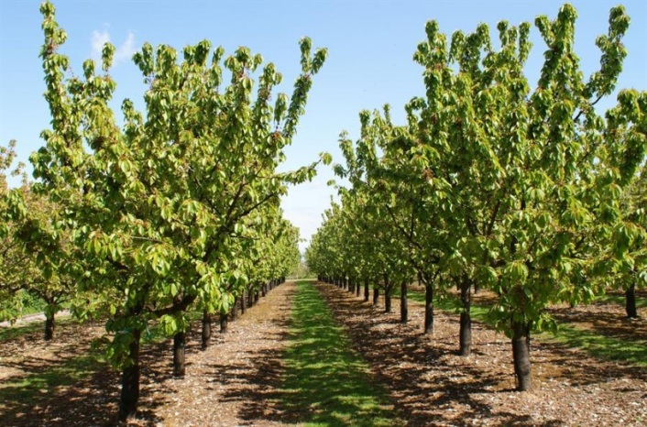
Four Segments of Agriculture
Leases
Ranching
Row Crops
Permanent Plantings

Slide 33
Percent of Investment in Land &
Operational Assets
Operation Type % Land % Op
Lease 90% 10%
Cattle 85% 15%
Row Crops 60% 40%
Permanent Plantings 50% 50%

Slide 34
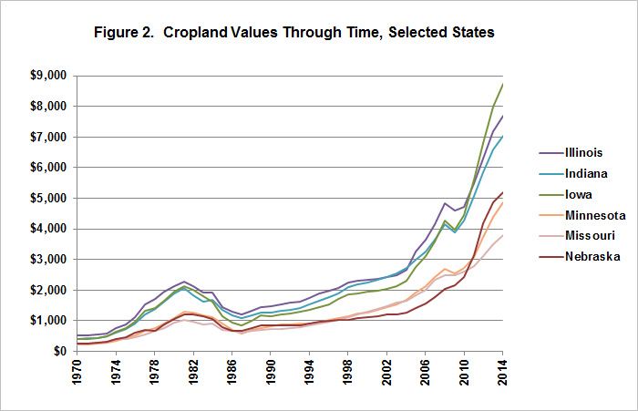
Agri Land Appreciation

Slide 35
Agri Land Risk
Agriculture land investments achieve competitive returns and are solid investments
Ag land has been comparable in risk and return to the T Bill over the years
Investing in ag land is considered an essentially “risk-free investment”

Slide 36
Sharpe Ratio Definition
The Sharpe Ratio is a constant used in developing a risk premia for an investment based on the risk-return ratio against other investments.
Examples:
If an investment is less risky than the S&P, then its Risk Premium is lower.
If an investment is more risky than the S&P, then its Risk Premium is higher.

Slide 37
Hurdle Rate Model
Hurdle Rate = Risk Free Rate + Project Risk Premium
10-year Treasury Yield
(5%)
Weighted Land and Operational Risk as determined by variances

Slide 38
% Standard Deviation Computation
Land
Year Land Price % Change
1998 $1420
1999 $1530 7.75%
2000 $1670 8.15%
2001 $1890 12.17%
2002 $1890 9.58%
2003 $2090 9.09% 8.09%
2004 $2280 7.33% SD % Change
2005 $2470 7.50% (among upper 48 states)
2006 $2680 8.96%

Slide 39
Cattle Land Risk Premium
Computation
Land Premium = % Land X Variation (SD) X Sharp Ratio
Cattle Land Premium = (.85) X (8.09) X (.4) = 2.75%

Slide 40
Premia Using Sharpe Ratio
Commodity OP ∆ Land ∆
Cattle 0.75% 2.75%
Corn
Wheat 3.75% 1.95%
Potatoes
Almonds
Pistachios 5.75% 1.60%
Walnuts

Slide 41
Cattle Hurdle Rate
Hurdle Rate = Risk Free Rate + Project Risk Premium
10-year Treasury Yield
(4%)
Weighted Land and Operational Risk as Compared to S & P
4% + 2.75% (land ∆) + 0.75% (operational ∆) = 7.5%

Slide 42
Hurdle Rates
In comparison with the T Bill and S&P, given the Risk/Return potentials, the model suggested the following hurdle rates :
1) Lease Properties 4.0% + 3.5% = 7.5%
2) Cattle Operations 4.0% + 3.5% = 7.5%
3) Row Crops 6.0% + 3.5% = 9.5%
4) Permanent Plantings 9.0% + 3.5% = 12.5%

Slide 43
The Bottom Line
Through years of analyses this model suggest that one can pay no more than $10,000/cow for land and achieve the hurdle rate of…
4% (operating) + 3.5% (appreciation) =
7.5% (total return)

Slide 44
Risk Grid
Highest
Risk
Highest
Return
Lowest
Risk
Lowest
Return

Slide 45
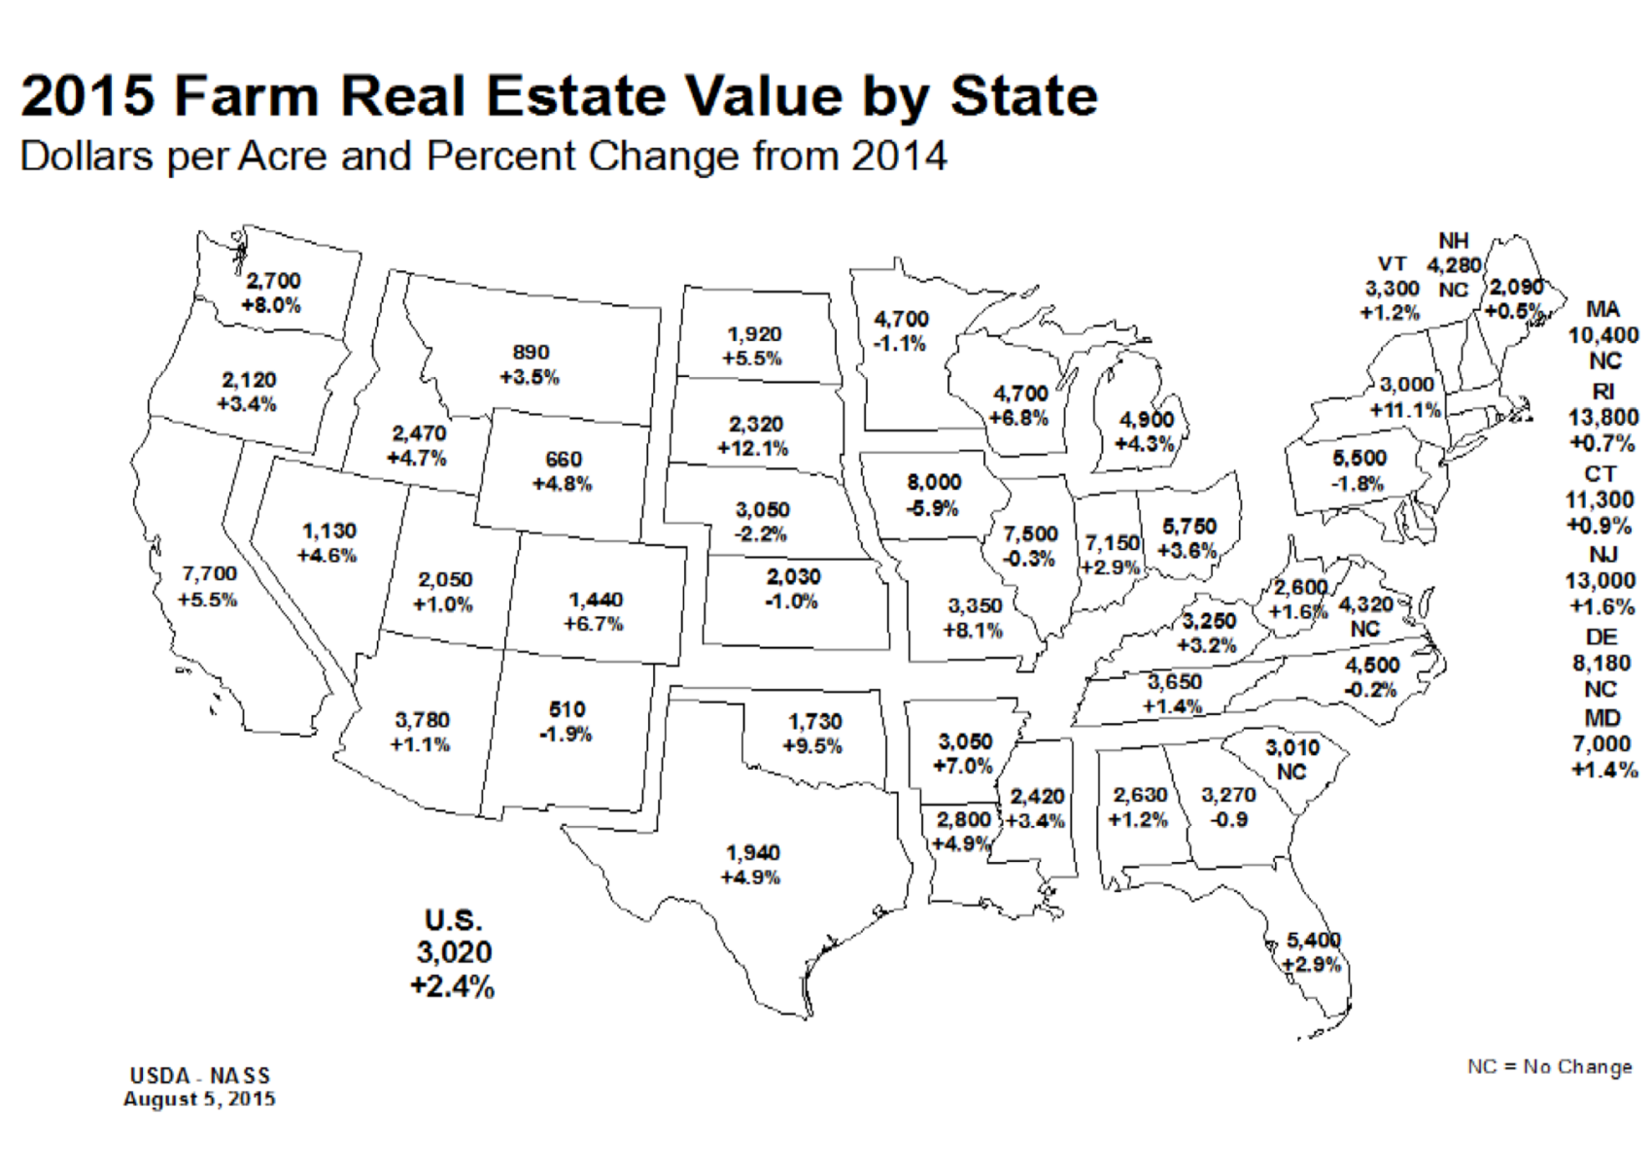
Farm Real Estate Value by State

Slide 46
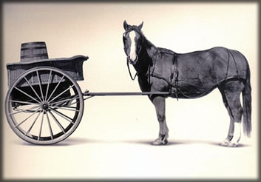
A Couple of Other Points
1) Don’t fall in love with a potential acquisition.
2) Strategy should drive acquisitions

Slide 47
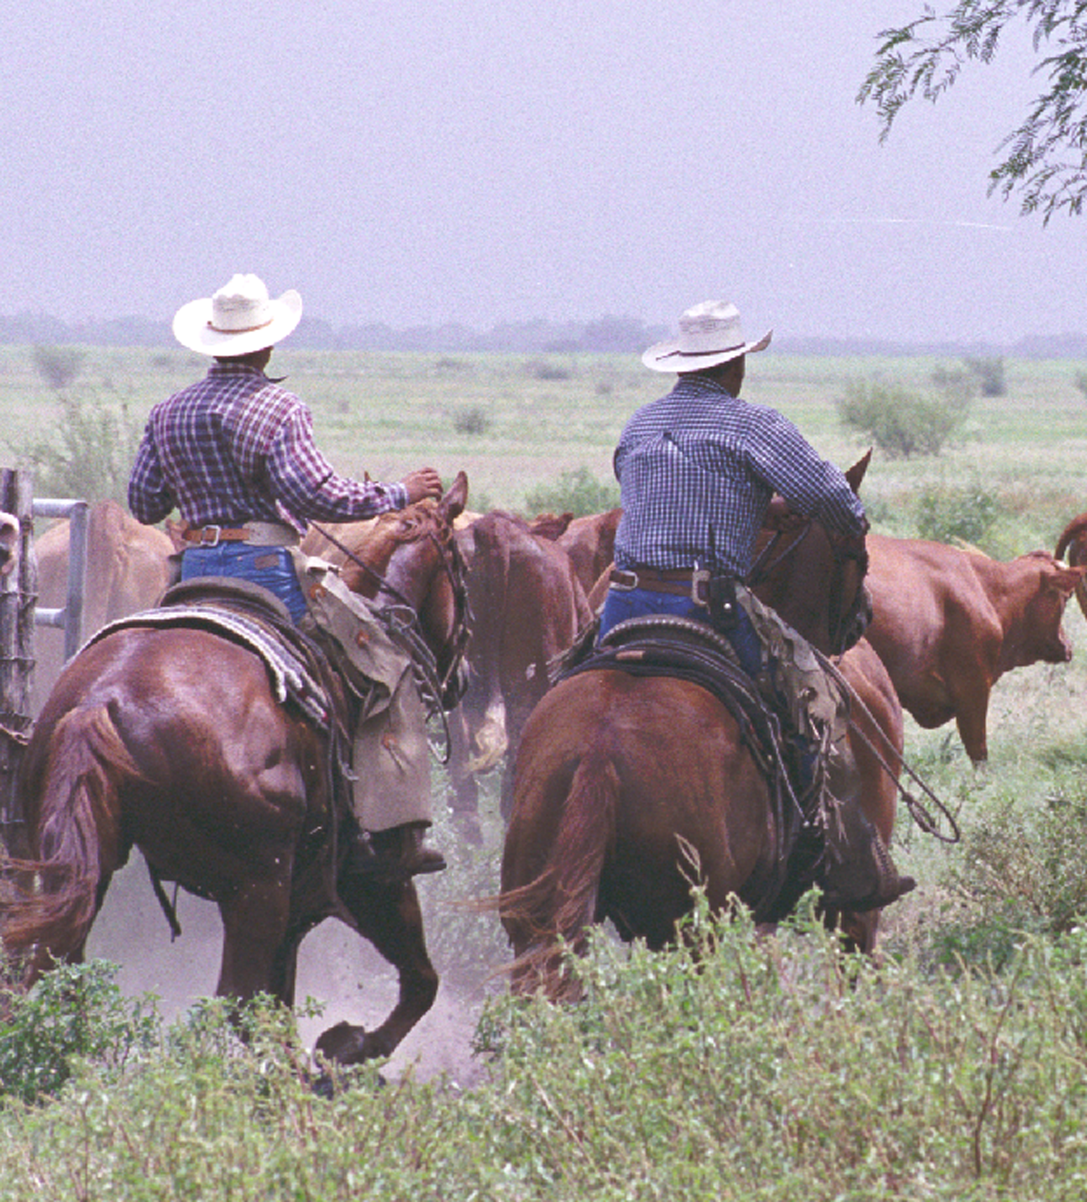
Thank You

